Slide 1
AAROGYA
PREPAREED BY:R.dileep

Slide 2

Click disease name button it shows some disease.

Slide 3
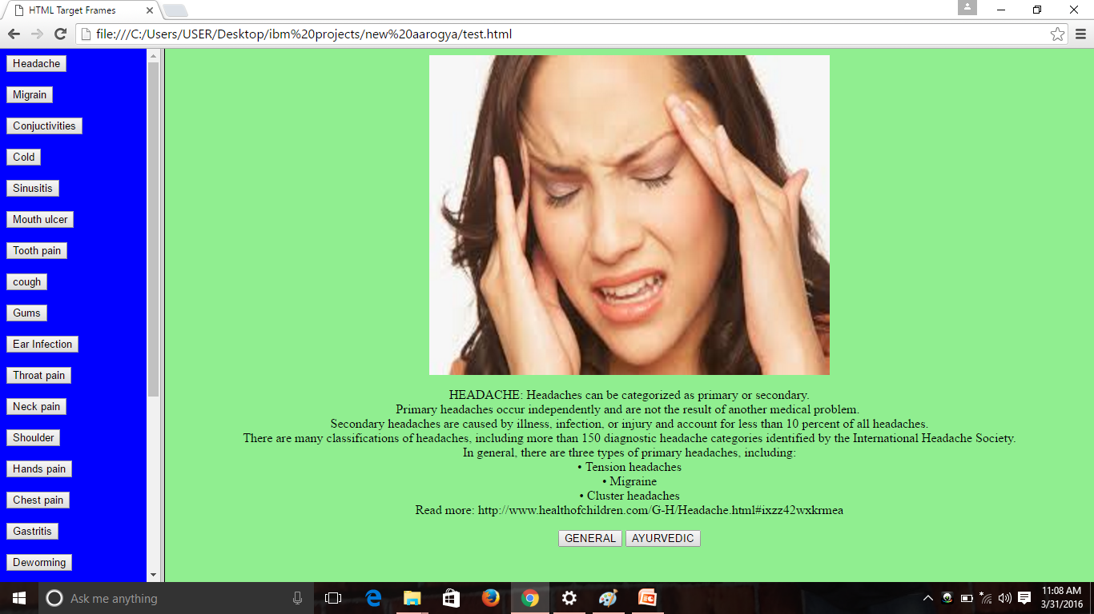
Click general button you will get medicine.

